Slide 1
Cracking Codes
in
Latin Inscriptions

Slide 2
Notes:
dìs manibus / Q(uinti) ° Manli ° / Celeris
To the departed spirits of Quintus Manlius Celer
A nice simple tombstone to start with. Quintus Manlius is in the genitive.

Slide 3
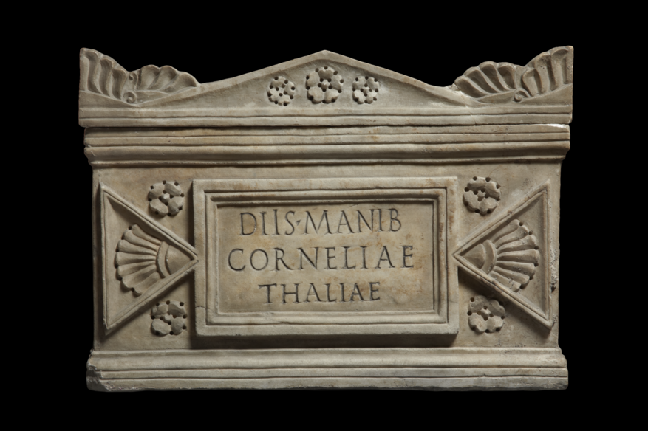
Notes:
diìs ° manib(us) / Corneliae / Thaliae
“To the departed spirits of Cornelia Thalia.”
The unusual spelling and abbreviation might make ”Dis Manibus” slightly harder to spot here.

Slide 4
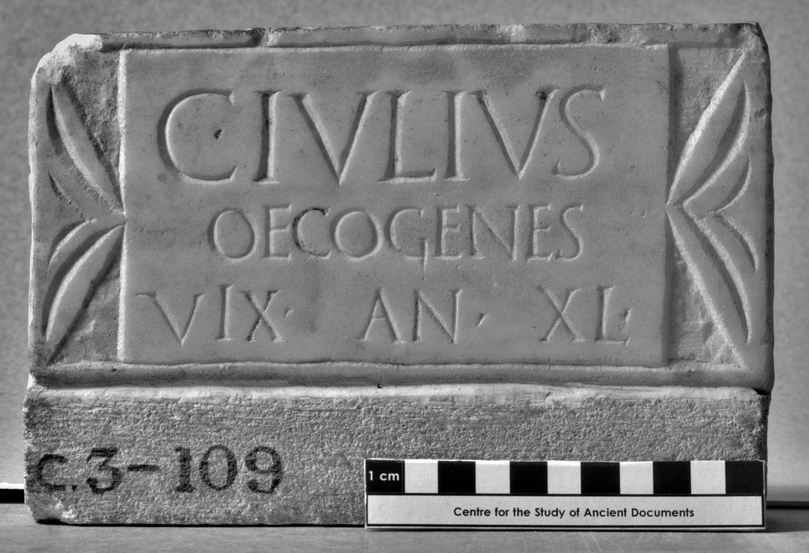
Notes:
C(aius) ° Iulius / Oecogenes / vìx(it) ° an(nos) ° XL °
‘Gaius Iulius Oecogenes lived for 40 years.
It was more common for older adults to round their age to the nearest five years. There are many more tomb stones with round numbered ages over the age of 20 than we would expect.

Slide 5
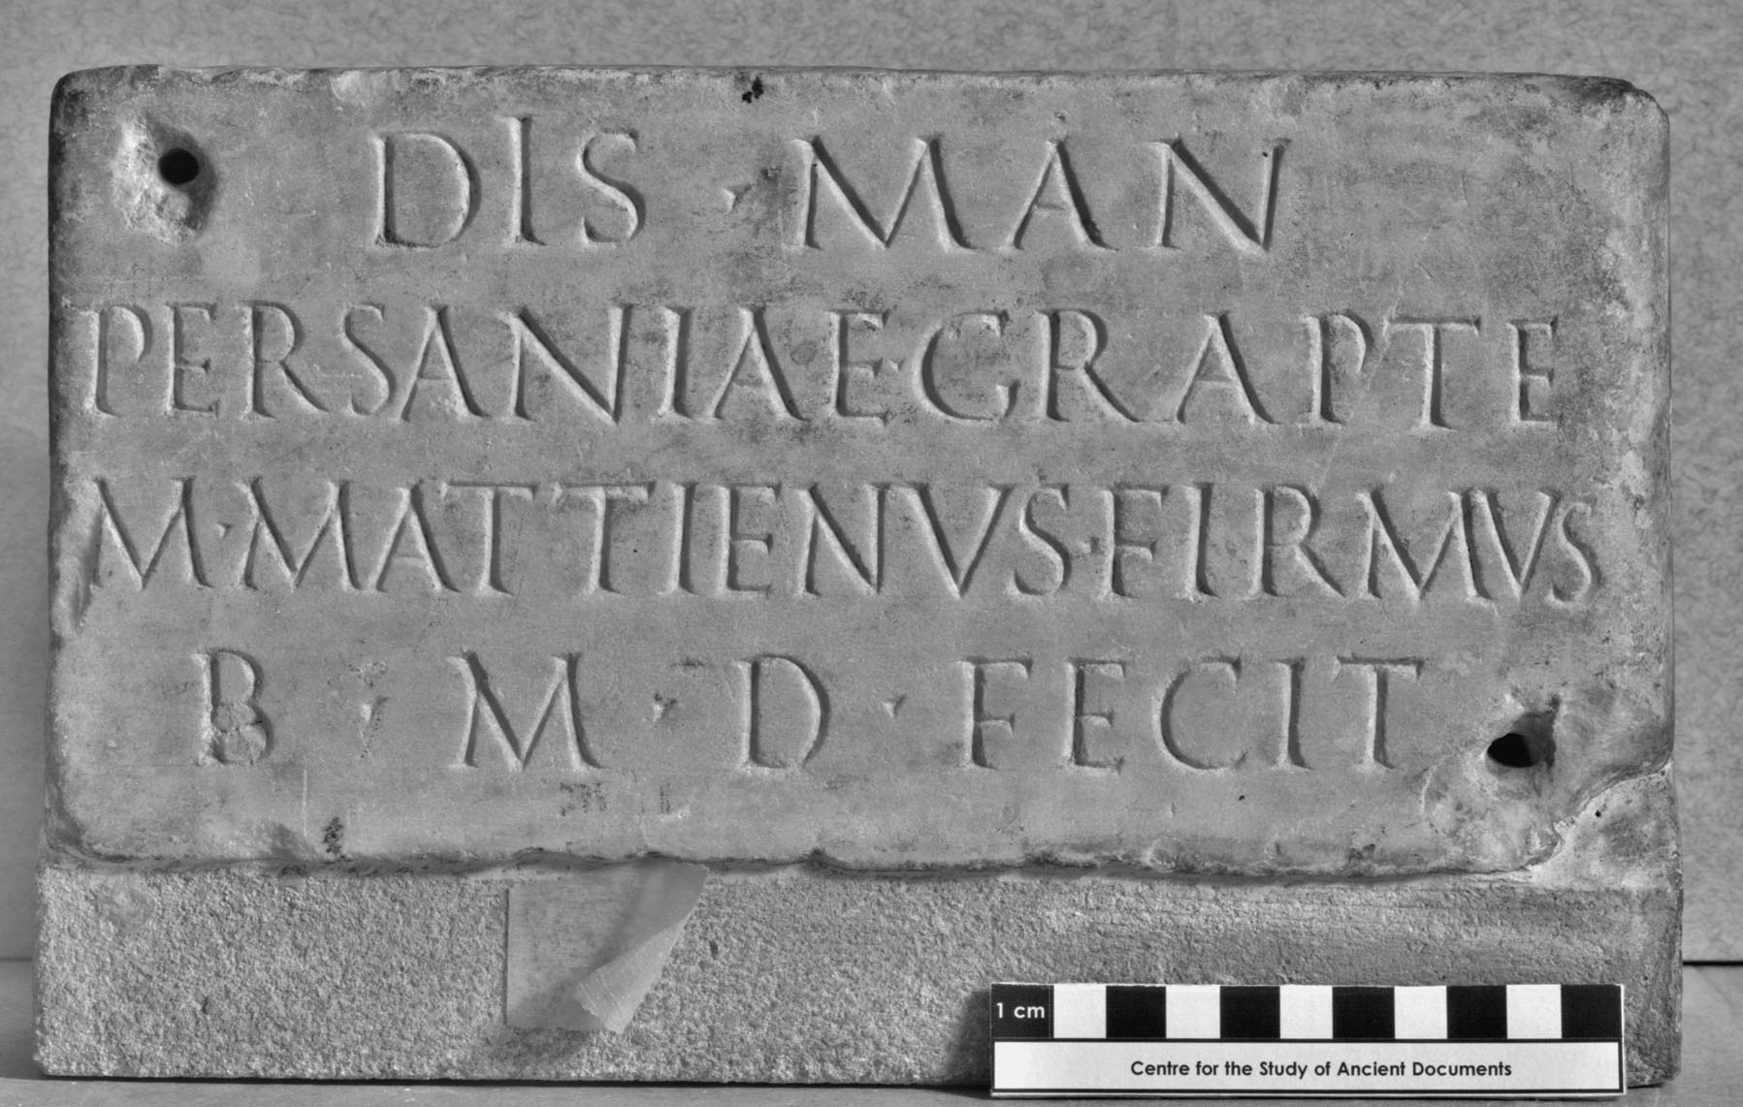
Notes:
dìs ° man(ibus) / Persaniae ° Grapte / M(arcus) ° Mattienus ° Firmus / b(ene) ° m(erenti) ° d(e) ° <se> fecit
‘To the spirits of the dead. Marcus Mattienus Firmus set this up for Persania Grapte who deserved well of him.’
There are two names on this tomb stone. We can tell who is the deceased and who set up the inscription by the case of the names. Persania Grapte appears in the dative and Mattienus Firmus in the nominative.

Slide 6
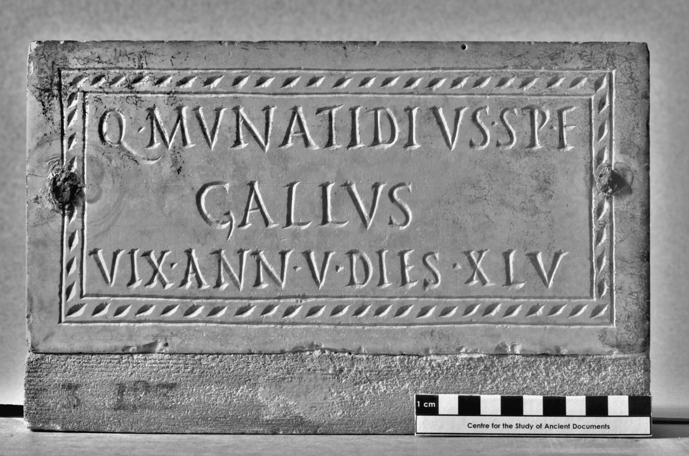
Notes:
Q(uintus) ° Munatidius ° Sp(uri) ° f(ilius) / Gallus / vix(it) ° ann(os) ° V ° dies ° XLV
‘Quintus Munatidius Gallus, son of Spurius, lived 5 years and 45 days.’

Slide 7
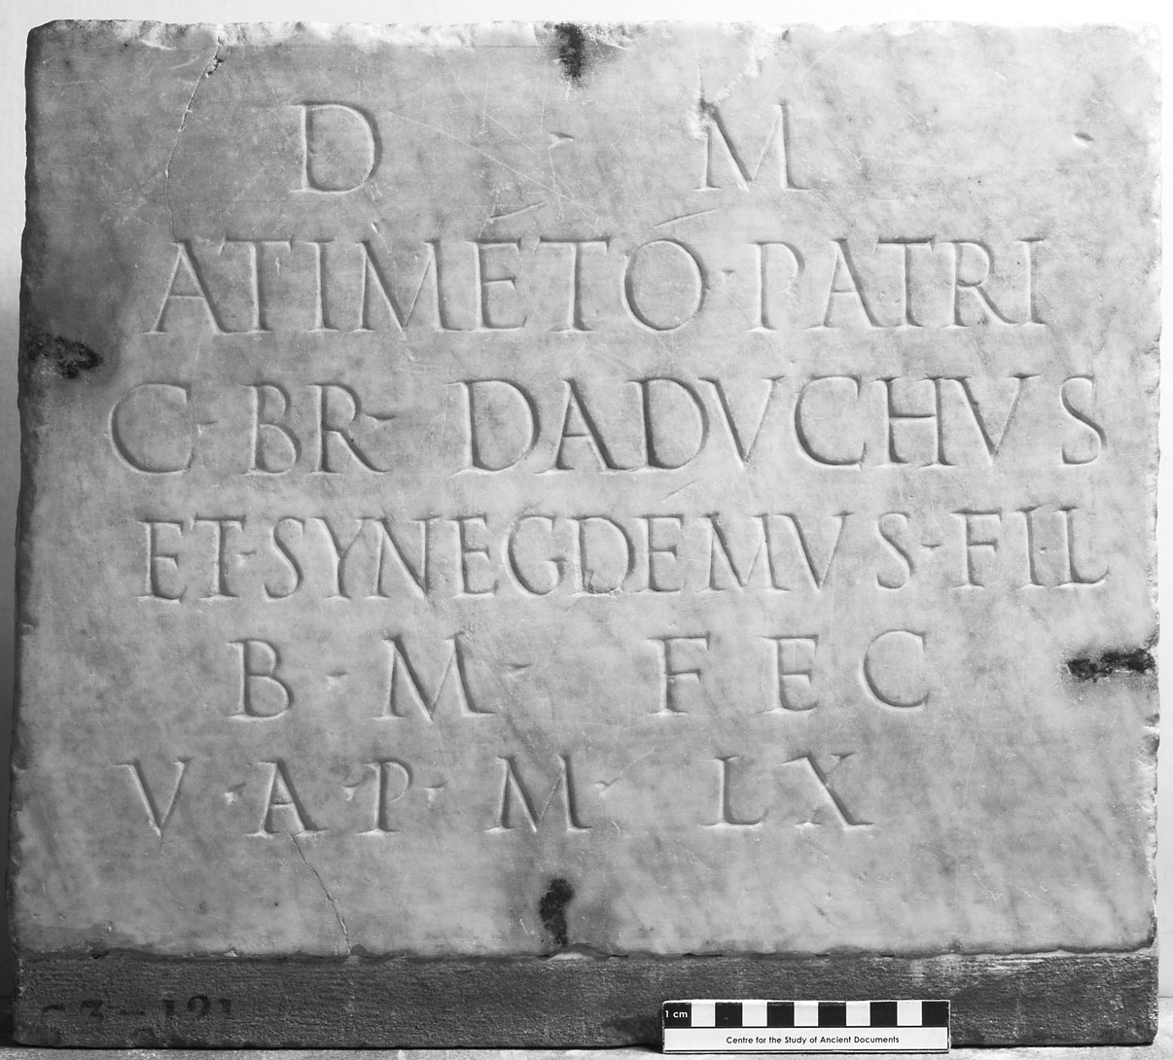
Notes:
d(is) ° m(anibus) / Atimétó ° patri / C(aius) Br(---) Daduchus / et Synegdémus fil(ii) / b(ene) ° m(erenti) ° fec(erunt) / v(ixit) ° a(nnos) ° p(lus) ° m(inus) ° LX
‘To the spirits of the dead. Gaius Br(---) Daduchus and Synegdemus, his sons, set this up to their well-deserving father Atimetus, who lived for 60 years more or less’.

Slide 8
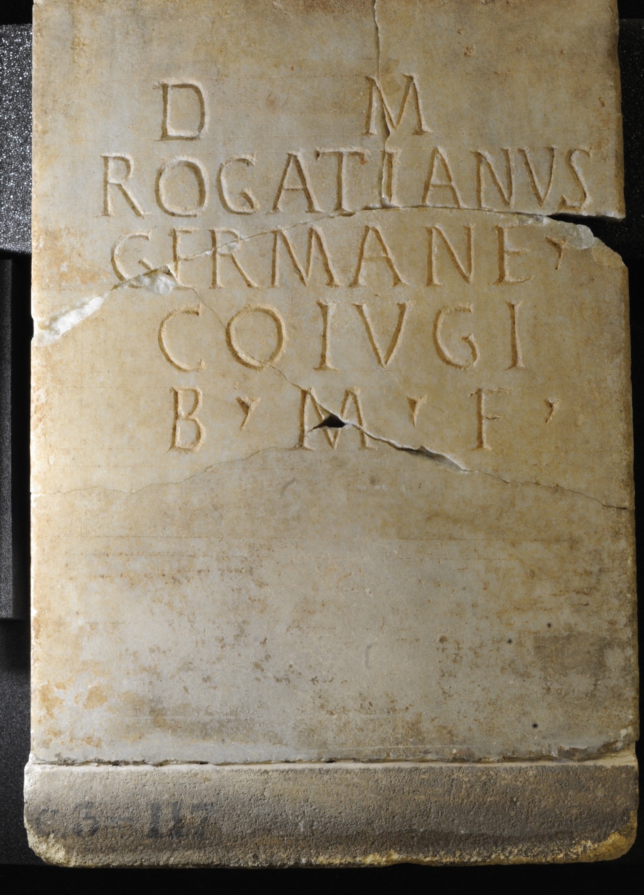
Notes:
d(is) m(anibus) / Rogatianus / German(a)e ° / co(n)iugi / b(ene) ° m(erenti) ° f(ecit)
‘To the spirits of the dead. Rogatianus set this up for his well-deserving wife Germana.’

Slide 9
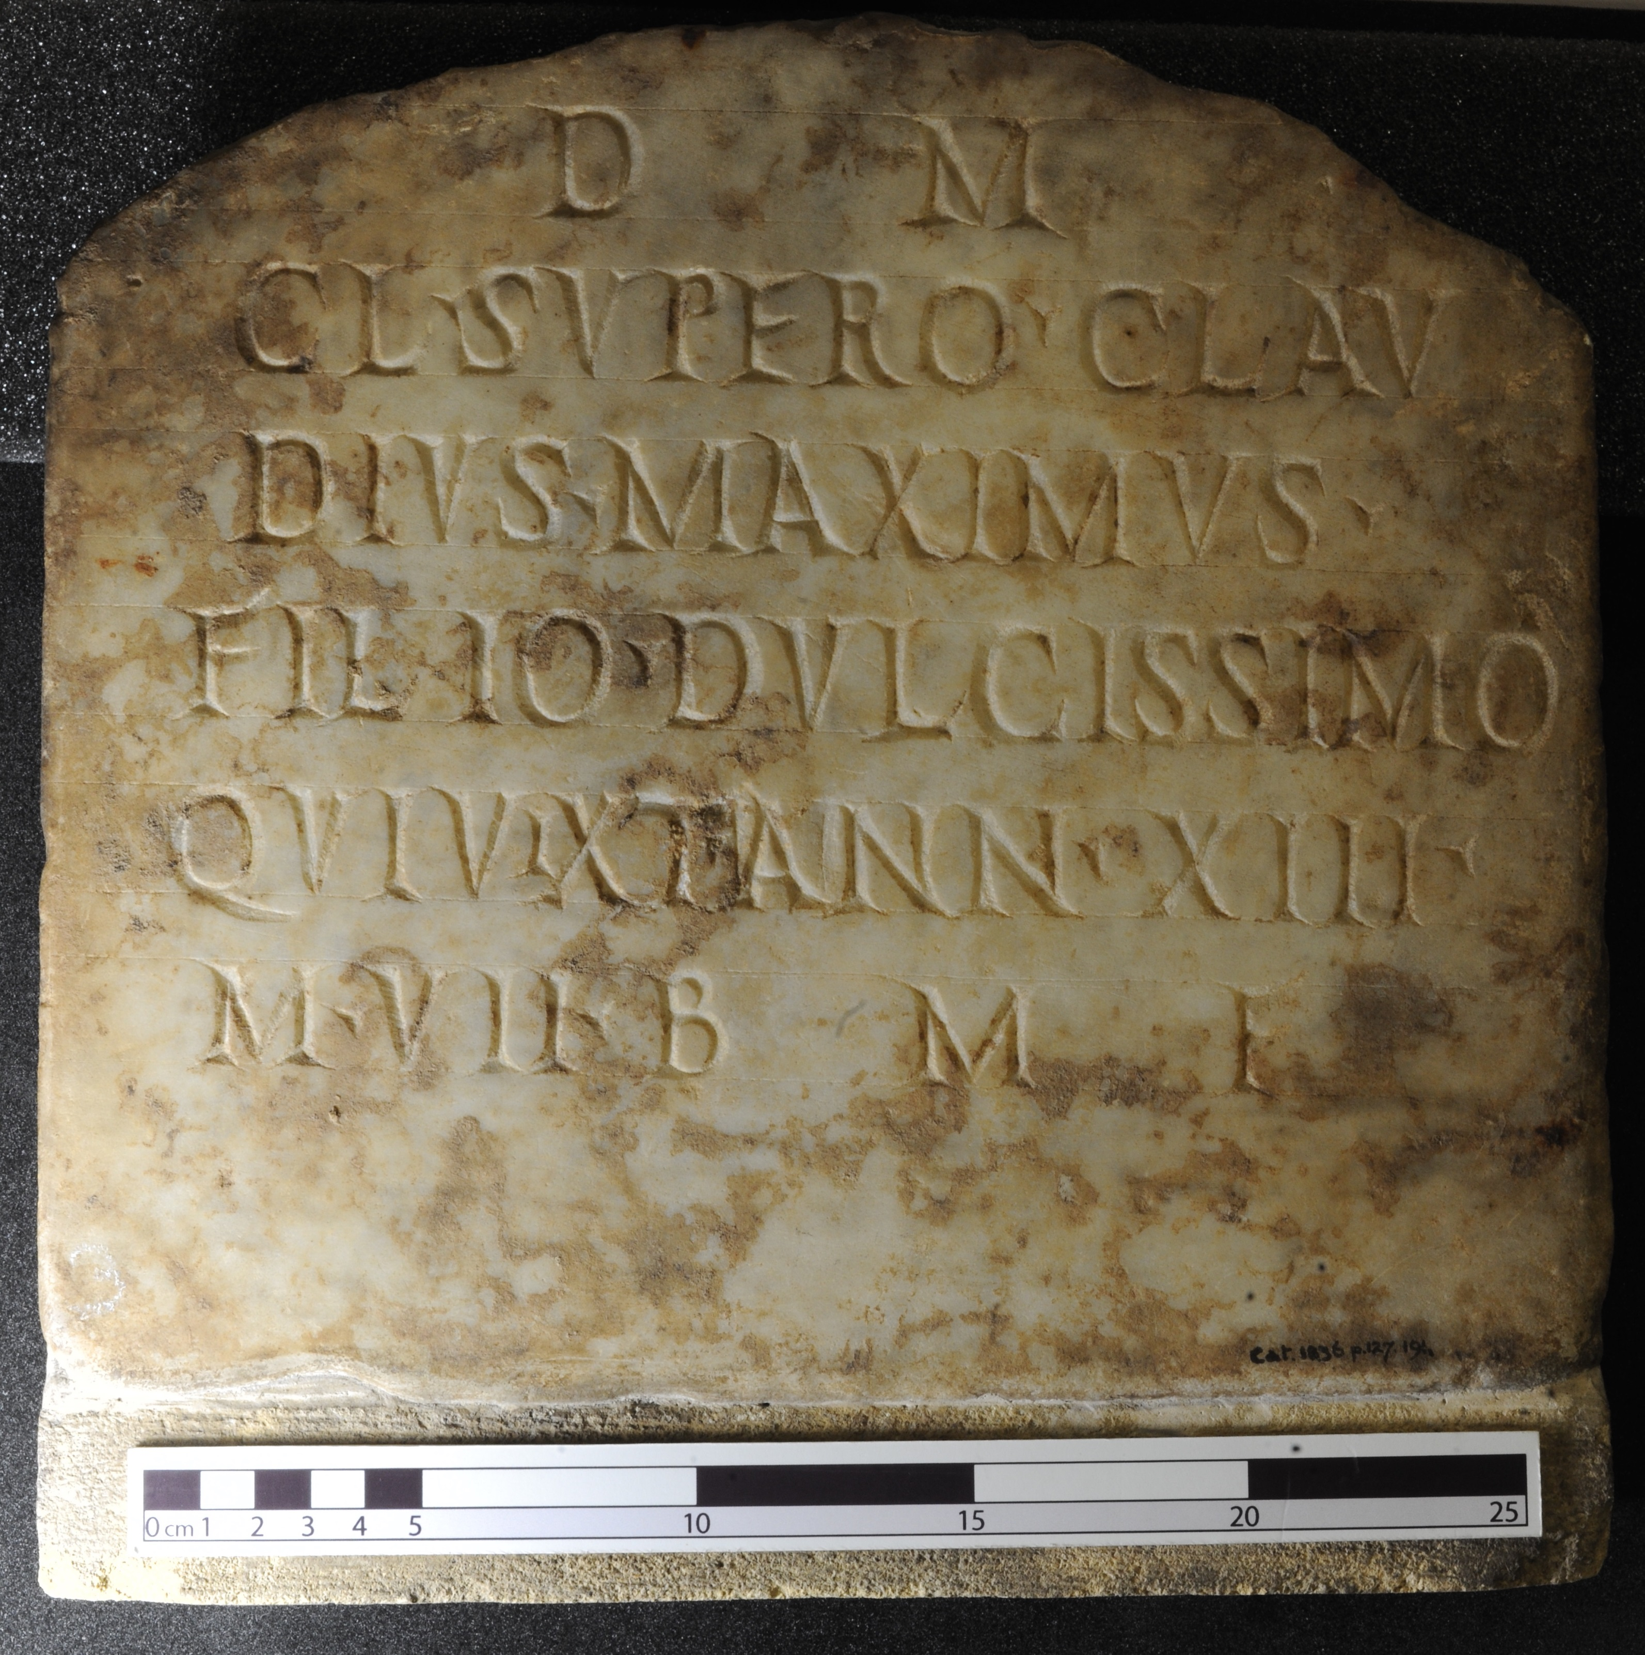
Notes:
d(is) m(anibus) / Cl(audio) ° Supero ° Clau/dius ° Maximus ° / filio ° dulcissimo / qui vix<i>t ann(is) ° XIII ° / m(ensibus) ° VII b(ene) m(erenti) f(ecit)
‘To the departed spirits. To Claudius Superus. Claudius Maximus set this up for his sweetest son who lived 13 years, 7 months, well-deserving.’

Slide 10
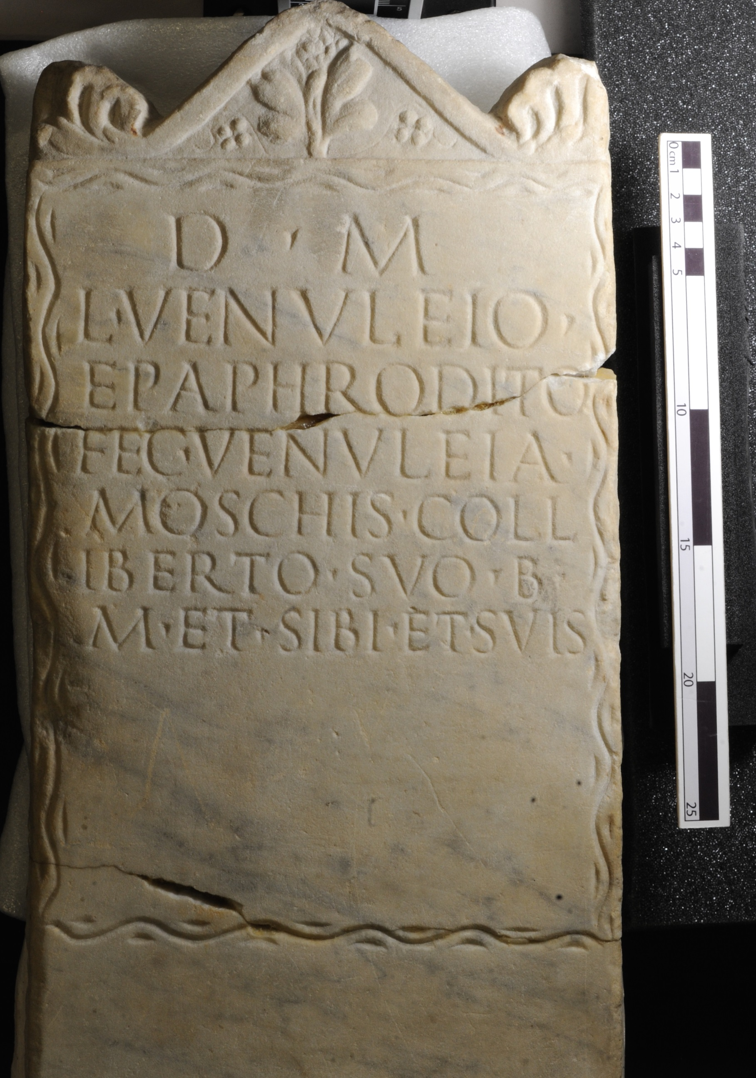
Notes:
d(is) ° m(anibus) / L(ucio) ° Venuleio ° / Epaphrodito / fec(it) ° Venuleia ° / Moschis ° coll/iberto ° suo ° b(ene) ° / m(erenti) ° et ° sibi ° et ° suis
‘To the departed spirits. To Lucius Venuleius Epaphroditus. Venuleia Moschis set this up for her well-deserving fellow-freedman and for herself and for her family.’
There is a large gap on this stone that hasn’t been written on. This may indicate that the stone and decoration were pre-fabricated then personalised with writing.

Slide 11
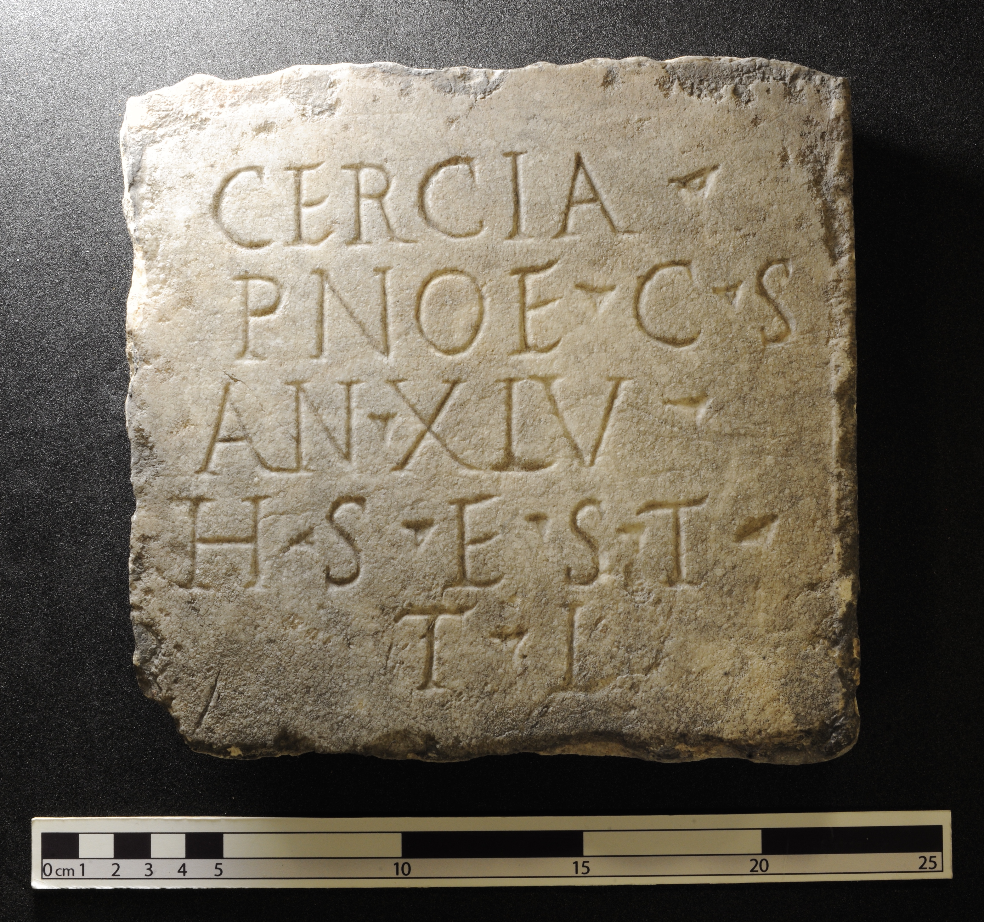
Notes:
Cercia ° / Pnoe ° c(ara) ° s(uis) / an(norum) ° XLV ° / h(ic) ° s(ita) ° e(st) ° s(it) ° t(ibi) ° / t(erra) ° l(evis)
‘Cercia Pnoe, dear to her family, 45 years old, is buried here. May the earth lie lightly upon you.’

Slide 12
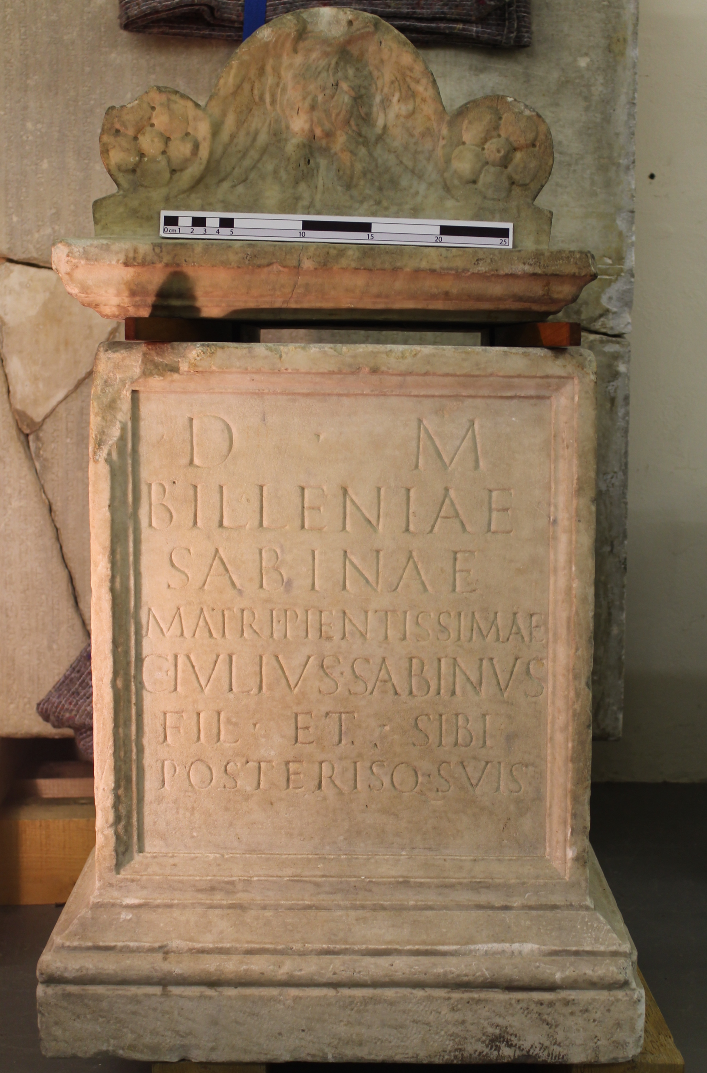
Notes:
d(is) ° m(anibus) / Billeniae / Sabinae / matri ° pientissimae / C(aius) ° Iulius ° Sabinus / fil(ius) ° et ° sibi / posterisq(ue) ° suis
‘To the spirits of the dead. Gaius Iulius Sabinus, her son, set this up for Billenia Sabina, most devoted mother, and for himself and his descendants.’

Slide 13
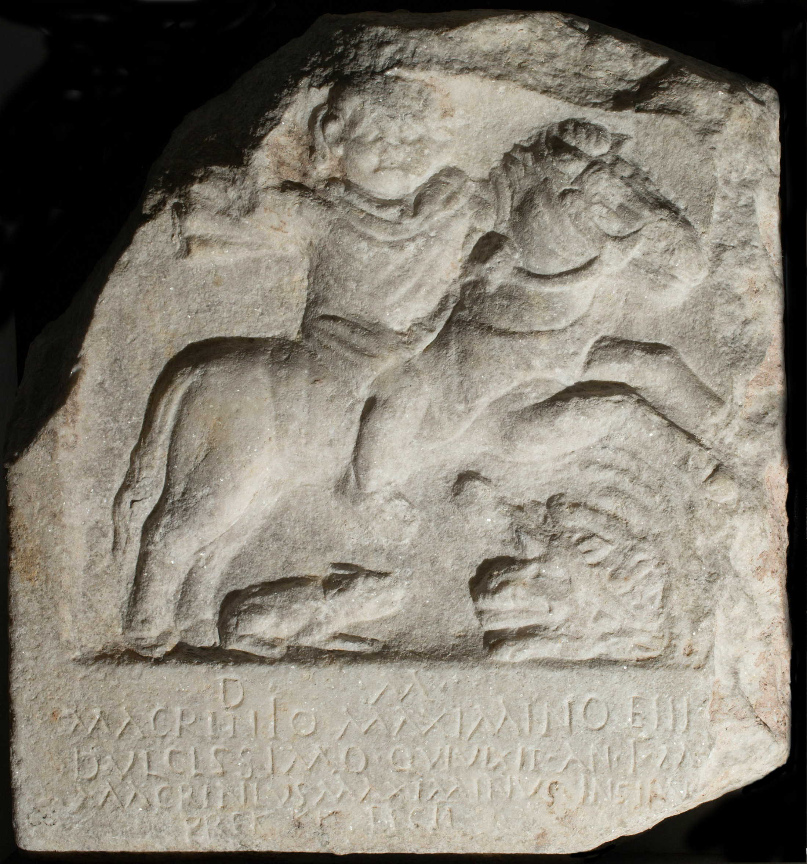
Notes:
d(is) ° m(anibus) ° / Macrinìo Maximino ⌈f⌉i⌈l⌉i[o] / dulcissimo ° qui vixit ° an(no) ° I ° m(ensibus) ° [-] / Macrinius Maximinus Insiru[-] /5 pr(a)ef(ectus) (castrorum) ° fecit °
‘To the departed spirits. To Macrinius Maximinus, sweetest son, who lived for one year and [?] months. Macrinius Maximinus Insiru[-], prefect of the camp, set this up.’
Pictures of riders on horseback were common on Roman tombstones to celebrate the deceased’s skill in hunting or battle. This stone commemorated a one year old child, so the image is imaginary. You can see his baby like features and tiny horse and dog. Perhaps this shows hopes for a future he never got to grow into.
The stonecutter made a mistake in carving “FILIO” on the stone, instead carving “EIIIO”

