Slide 1
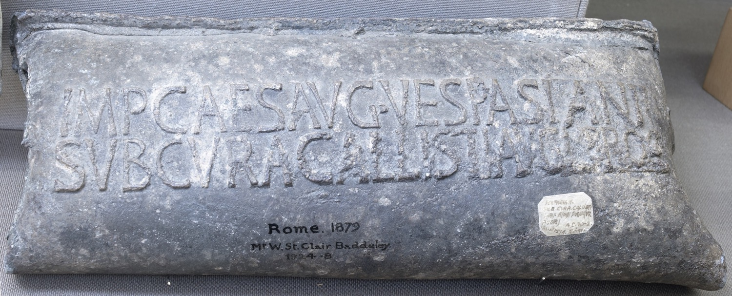
The Ashmolean Latin Inscriptions Project
Notes:
This is a section of lead water pipe from near the Porta Maggiore, a gate on the eastern side of Rome. It was big enough to supply water for 16 households.
This water supply was provided by the state and was a source of great pride. This section of the pipe includes the name of the emperor and the official who oversaw its construction, so that people would know who was responsible.
The inscription reads:
“Of Imperator Caesar Augustus Vespasian, under the management of Callistus, imperial freedman, procurator”.
Compare:
A long section of Roman lead piping still in the ground at Bath (this pipe would have been covered in Roman times): http://www.timetrips.co.uk/roman_bath_caerleon.htm
Details:
Lead, length 37cm, AN1924.8

