Slide 1
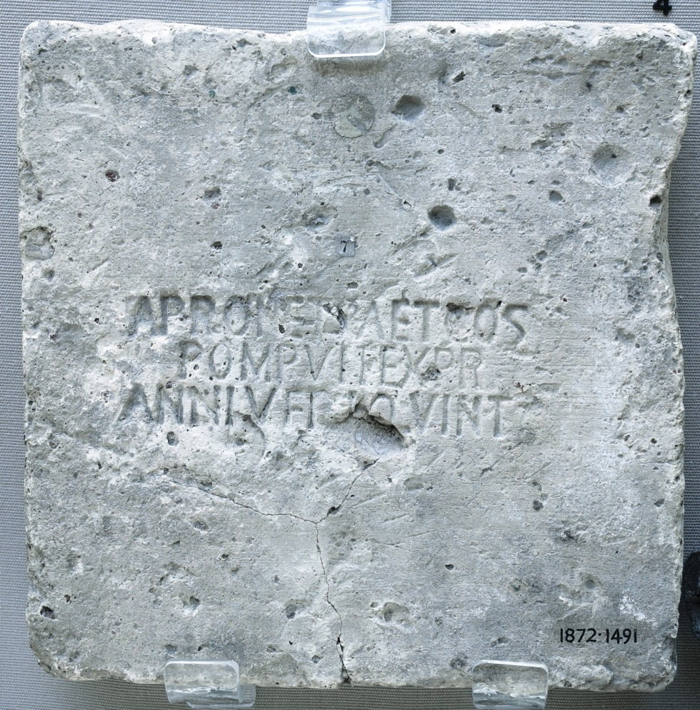
The Ashmolean Latin Inscriptions Project
Notes:
Roman bricks were not rectangular like ours. They were square and narrow, like giant cream crackers. For making walls, Roman builders lay them flat, with their narrow edges facing out.
Quintanensia was a clay-rich area outside Rome. Many land-owners there became rich by allowing brick-manufacturers to set up brick factories on their land.
The bricks were often stamped with the name of the manufacturer, just like a maker’s mark today. Different companies also had different logos, such as birds, chariots or gods, to show off their work. This brick is different in that it gives the name of the manufacturer, the name of the person whose land the clay came from, and the date (Roman consuls were a pair of magistrates that changed every year, so Romans used their names as a way of giving the date). In this case, we can tell that the brick was made in AD 123.
The inscription reads:
APRON. ET PAET. COS. POMP. VIT. EX. PR. ANNI. VERI. QUINT.
‘In the consulship of Apronianus and Paetinus, made by Pomponius Vitalis from the estates at Quintanensia of Annius Verus,’
Compare:
Surviving Roman walls in the harbour town of Ostia, http://www.ostia-antica.org
Details:
Clay, length 23cm, Ashmolean Museum AN1872.1491

