Slide 1
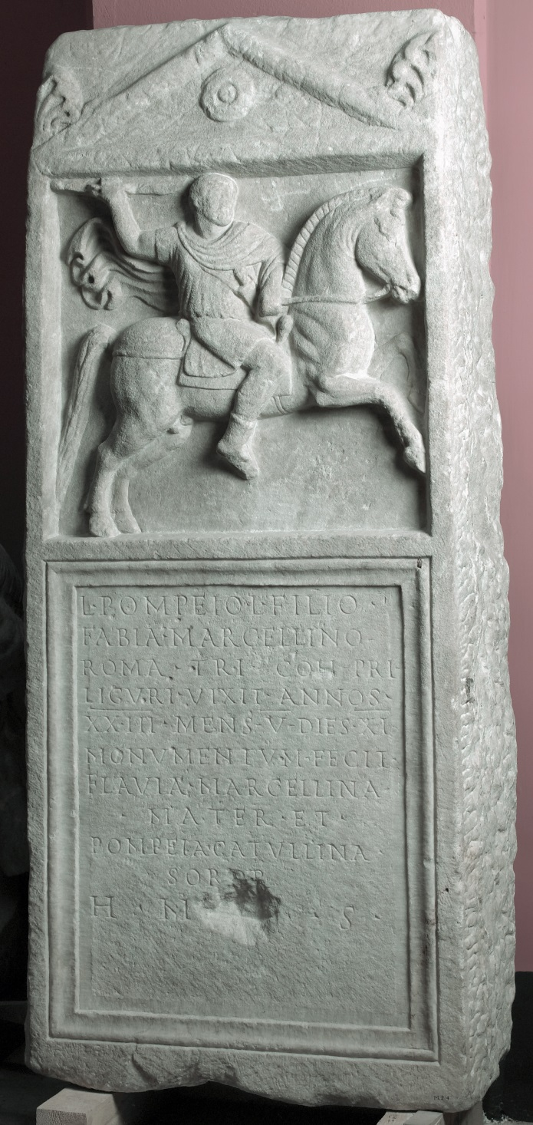
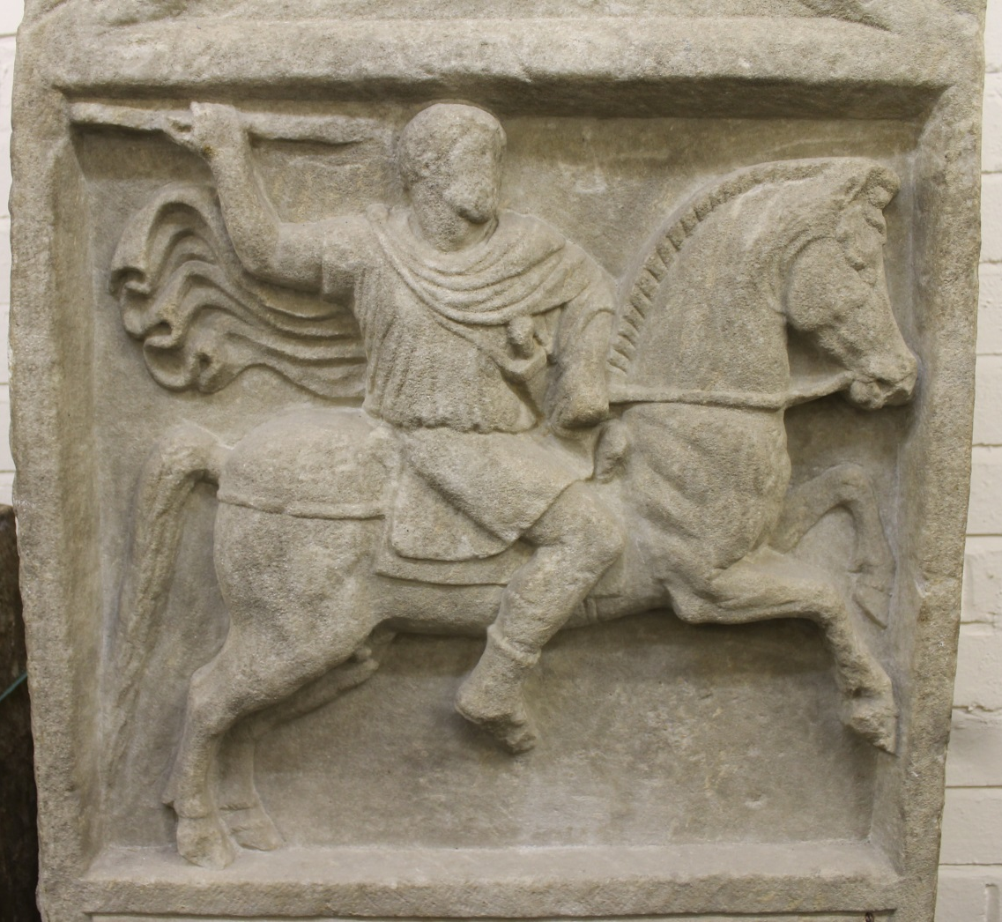
The Ashmolean Latin Inscriptions Project
Notes:
Galloping horsemen were popular on Roman tombstones, suggesting a glorious life of military campaigns and animal hunts.
On this large tombstone, the dead man has been shown at his best. He wears a short tunic and cloak, has a sword under his left arm, and a spear (now broken) in his right hand. Notice his beard, and the straps under the horse’s belly and under its tail to keep the saddle-cloth in place. The stonemason has made his cloak ripple out behind him to give the impression of speed.
Pompeius Marcellinus was a tribune (military commander) when he died at the age of 23. Originally from Rome, he died far away at Ephesos in Turkey, perhaps as he was making his way to join his military unit. His mother and sister set up his tombstone.
The inscription reads:
‘To Lucius Pompeius Marcellinus, son of Lucius, of the Fabian voting-tribe, from Rome, tribune of the first cohort of the Ligurians. He lived 23 years, 5 months, 11 days. His mother Flavia Marcellina built the monument and his sister Pompeia Catullina. This monument does not follow the heir.’
By saying that the ‘monument does not follow the heir’, Marcellinus’ mother and sister were making sure that no-one else in the family used the same tombstone. This was quite common in Roman times, and often people set up a single tombstone for several loved ones, even if they weren’t dead yet!
Compare:
The same design is used on the tombstone of a small child, on the AshLI Slides 1 - Child horseman.
Details:
Second-third centuries AD, marble. Ashmolean Museum AN1947.285.

